Slide 1
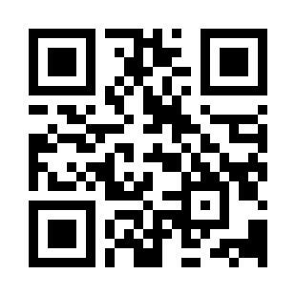


DOM and Events Quiz
https://bit.ly/3TU5NGV

